Slide 1

CS559 Deep Learning
Project Presentation
Inverse Problems with Deep Learning for CS-MRI
Group Members:
Aslı Alpman - 21501747
Beril Alyüz - 21601710

Slide 2
Table of Contents
Proposed Model
Architecture
Loss Design
Asymmetry Loss
Mean Square Form
Exponential Form
Inverse Form
Inner Loss
Results
Asymmetry Loss
Filter Number
Activation Function
Inner Loss
Test Results
Introduction
Compressed Sensing in MRI
Problem Formulation
Deep Learning in CS-MRI
ISTA-Net+
Architecture
Loss Function

Slide 3
Introduction
Compressed Sensing
Sparse representation of natural signals in a transform domain¹
Efficiency in terms of power, storage and time
MRI
Long scan times
Redundancies in the collected data²
[1] I. Orović, V. Papić, C. Ioana, X. Li, and S. Stanković, “Compressive Sensing in Signal Processing: Algorithms and Transform Domain Formulations,” Mathematical Problems in Engineering, 25-Oct-2016. [Online]. Available: https://www.hindawi.com/journals/mpe/2016/7616393/. [Accessed: 07-Apr-2021]. [2] J. C. Ye, “Compressed sensing MRI: a review from signal processing perspective,” BMC Biomedical Engineering, vol. 1, no. 1, 2019.

Slide 4

Introduction
Inside regularization term¹
D : regularization transform
g( . ) : regularization function
Λ : regularization parameter
[1] Y. Yang, J. Sun, H. Li, and Z. Xu, “ADMM-CSNet: A Deep Learning Approach for Image Compressive Sensing,” IEEE Transactions on Pattern Analysis and Machine Intelligence, vol. 42, no. 3, pp. 521–538, 2020.

Slide 5
Introduction
Iterative convex optimization algorithms such as ADMM, ISTA etc.¹
Hand-crafted sparsifying transforms constrained to be linear and invertible
Networks can learn forward and backward transform without any constraint ¹
[1] “Deep Magnetic Resonance Image Reconstruction: Inverse Problems Meet Neural Networks,” IEEE Xplore. [Online]. Available: https://ieeexplore.ieee.org/document/8962949. [Accessed: 17-Feb-2021]

Slide 6
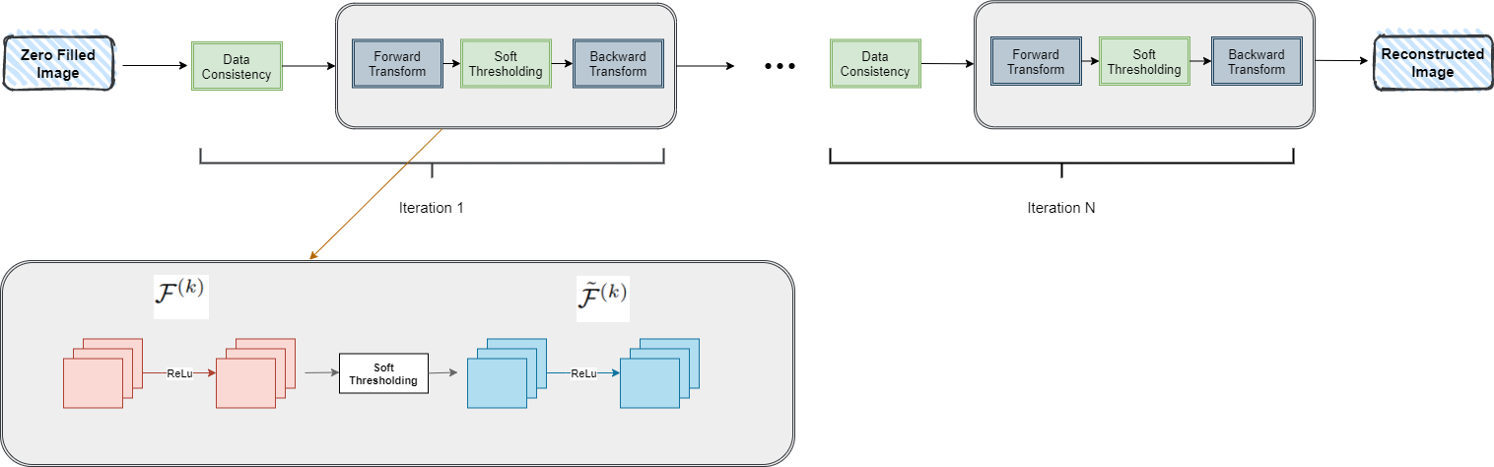
2. ISTA-Net+
2.1 Architecture
Fig 1: ISTA-Net Architecture¹
[1] J. Zhang and B. Ghanem, “ISTA-Net: Interpretable Optimization-Inspired Deep Network for Image Compressive Sensing,” 2018 IEEE/CVF Conference on Computer Vision and Pattern Recognition, 2018.

Slide 7
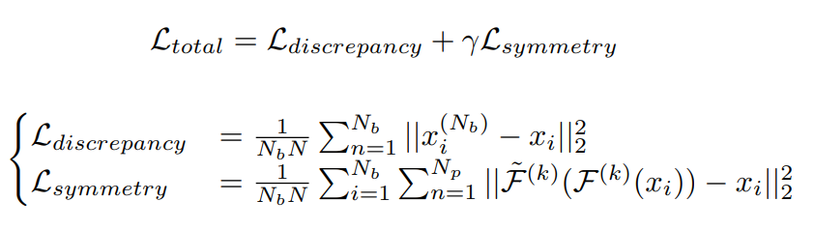
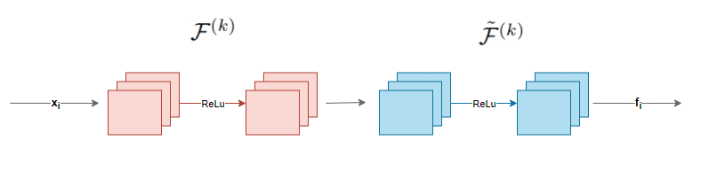
2.2 Loss Function
Fig 2: Symmetry loss calculation steps..

Slide 8
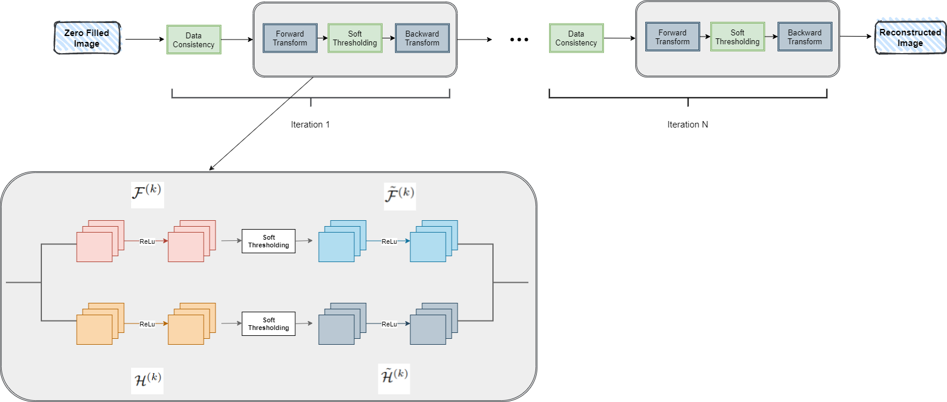
3. Proposed Model
Two “different” prior information-wise
Fig 3:Proposed Model Architecture.

Slide 9
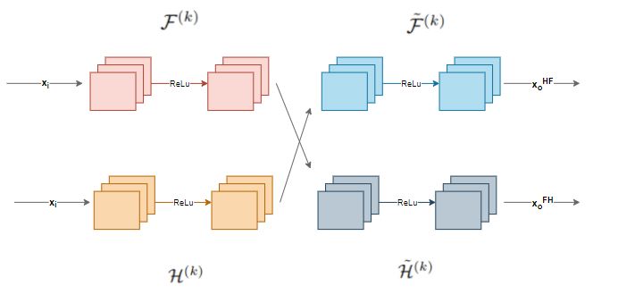
3.2 Loss Design
3.2.1 Asymmetry Loss
Fig 4: Asymmetry loss calculation steps.

Slide 10
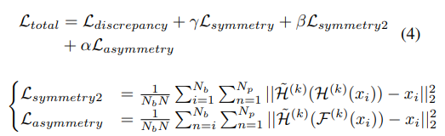

3.2.1.1 Mean Square Form

Slide 11
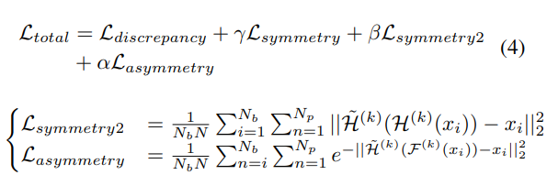
3.2.1.2 Exponential Form (One Sided)

Slide 12
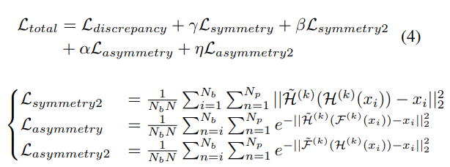
3.2.1.2 Exponential Form (Two Sided)

Slide 13
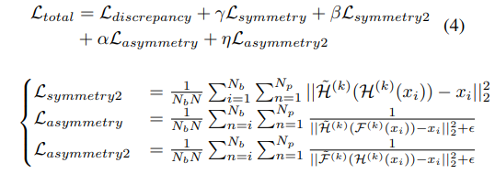
3.2.1.3 Inverse Form

Slide 14
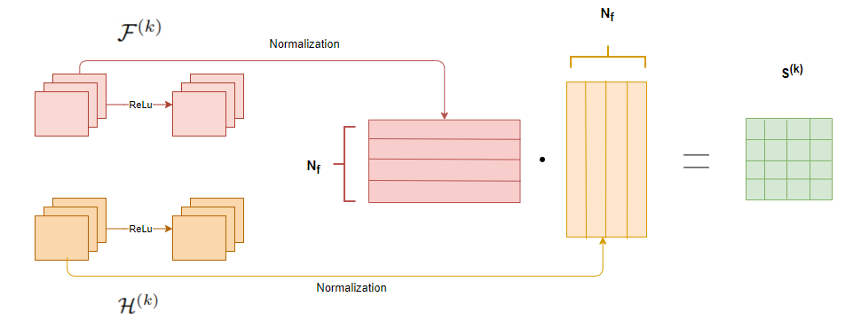
3.2.2 Inner Loss
Fig 5: Inner loss calculation steps.

Slide 15
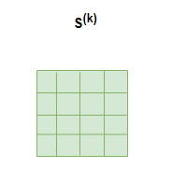
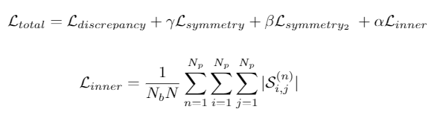
3.2.1 Inner Loss
Fig 6: Inner loss matrix.

Slide 16
3.3 Results
800 Brain MRI images for training and 50 test images for testing.
Manual separation of 800 images into 700 training and 100 validation images to babysit the learning process
Evaluated PSNR and SSIM for every epoch and use them as a metric for accessing the learning process

Slide 17
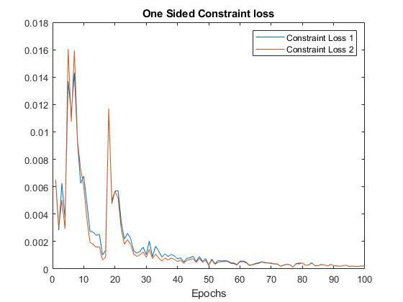
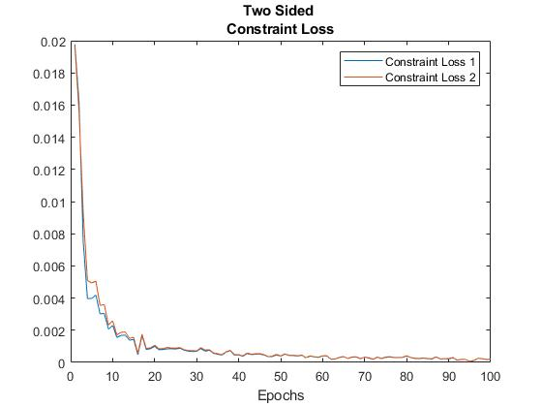
3.3.1 Asymmetry Loss Results: Loss Structure
Fig 7 : Constraint loss curves for exponential one-sided loss.
Fig 8 : Constraint loss curves for exponential two-sided loss.

Slide 18
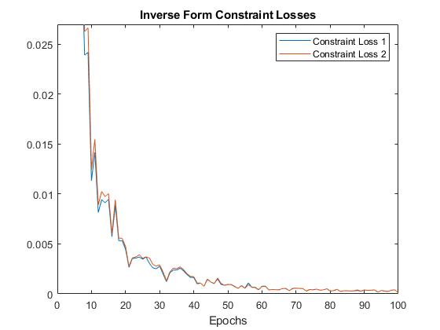
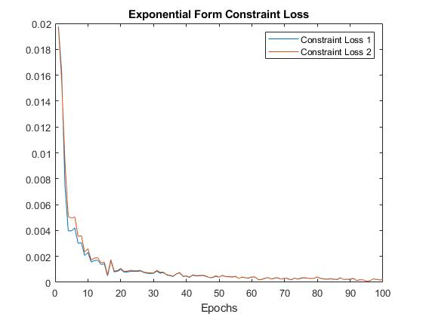
3.3.1 Asymmetry Loss Results: Loss Structure
Fig 9 : Constraint loss curves for inverse asymmetry loss.
Fig 10 : Constraint loss curves for exponential asymmetry loss.

Slide 19
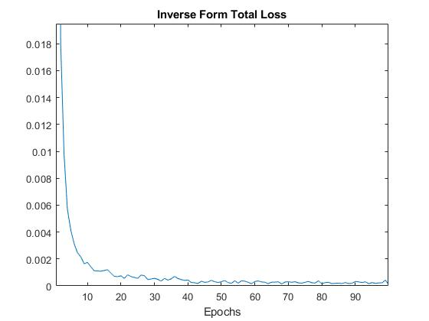
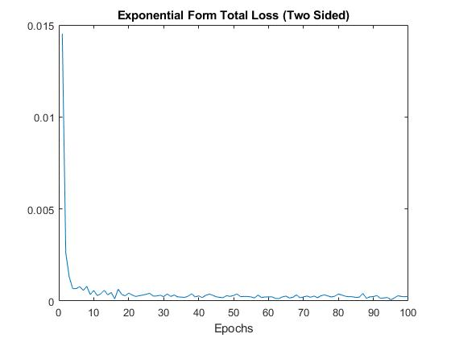
3.3.1 Asymmetry Loss Results: Loss Structure
Fig 11 : Total loss curves for inverse asymmetry loss.
Fig 12 : Total loss curves for exponential asymmetry loss.

Slide 20
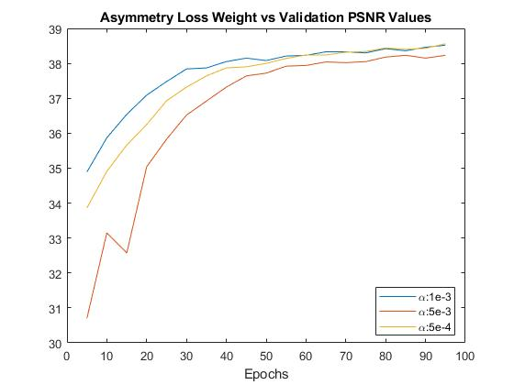
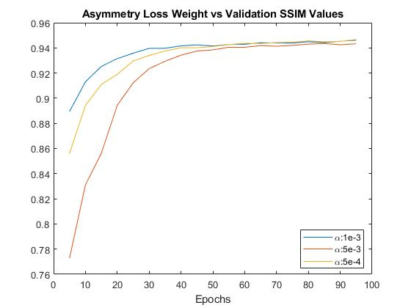
3.3.1 Asymmetry Loss Results: Weight Tuning
Fig 13 : PSNR values for different inverse asymmetry loss weights.
Fig 14 : SSIM values for different inverse asymmetry loss weights.

Slide 21
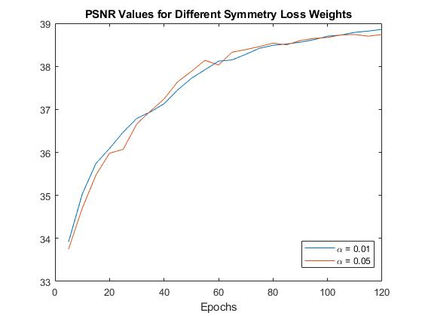
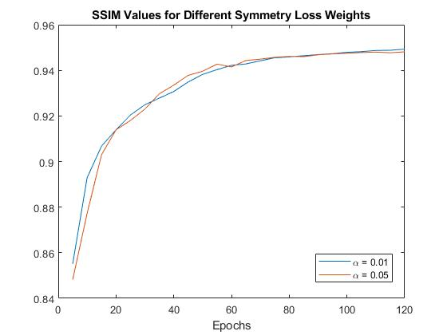
3.3.1 Asymmetry Loss Results: Weight Tuning
Fig 15 : PSNR values for different symmetry loss weights.
Fig 16 : PSNR values for different symmetry loss weights.

Slide 22
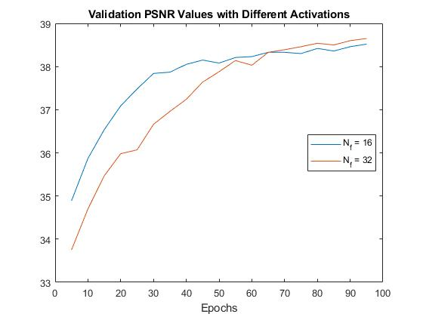
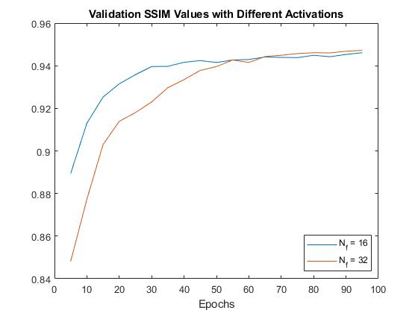
3.3.2 Filter Number
Fig 17 : PSNR values for different kernel sizes.
Fig 18 : SSIM values for different kernel sizes.

Slide 23
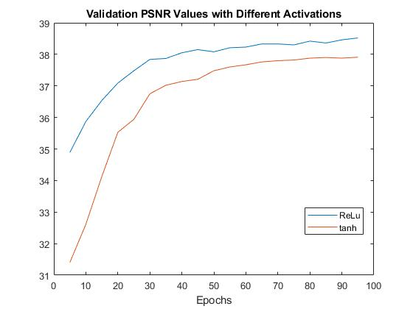
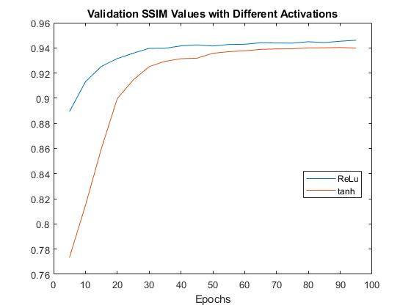
3.3.3 Activation Function
Fig 19 : PSNR values for different activation functions.
Fig 20 : SSIM values for different activation functions.

Slide 24
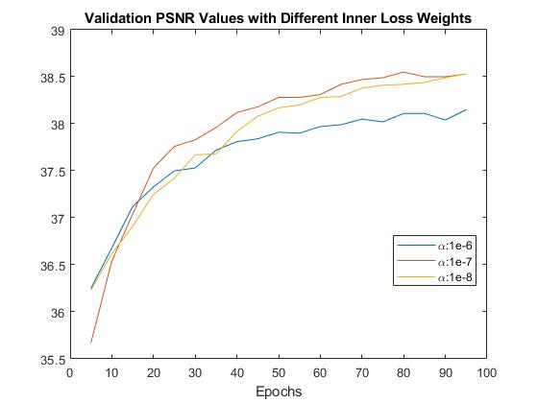
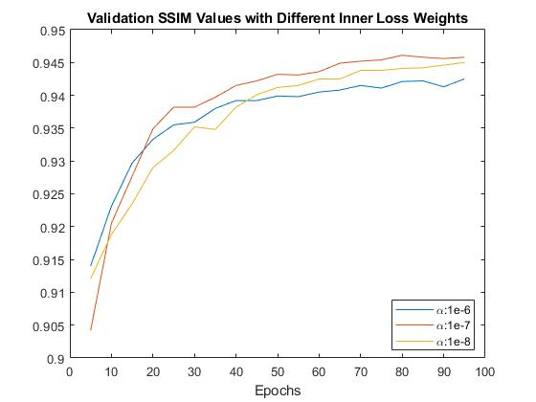
3.3.4 Inner Loss
Fig 21 : PSNR values for different inner loss weights.
Fig 22 : SSIM values for different inner loss weights.

Slide 25
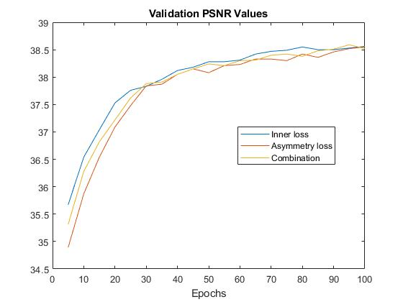
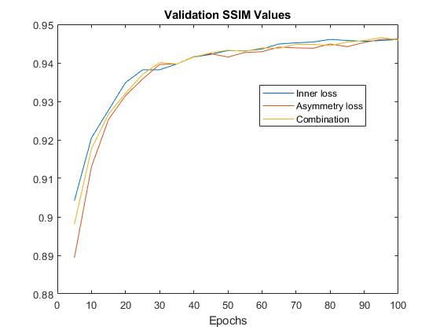
3.3.4 Inner Loss
Fig 23 : PSNR values for inner and asymmetry loss
Fig 24 : SSIM values for inner and asymmetry loss

Slide 26
3.3.5 Test Results
 | PSNR | SSIM
Inner Loss | 38.27 | 0.9451
Asymmetry Loss (16 filter) | 38.30 | 0.9454
Asymmetry Loss (32 filter) | 38.59 | 0.9478
ADMM-Net | 37.17 | -
ISTA-Net+ | 38.70 | 0.9484
Table 1 : Test PSNR and SSIM results.

